Slide 1
Predicting Dog Licenses Dispensed per Day
A study using AI on historical data to predict the number of dog licenses dispensed per day in Allegheny county

Slide 2
The Dataset
This dataset was obtained through data.gov
Allegheny county has posted a wealth of dog licensing information from 2007-2018
For the purpose of this study, 2015-2017 were used to train, and 2018 to test
The original dataset contained information on Dog Name, Breed, Color, Owner’s Zip, License Type, and Valid Date
Data was scrubbed of null and “hidden” null values and given a timestamp index using the Valid Date
A new univariate model that contained only daily totals of licenses dispensed was created for the purpose of this study that excluded weekends and holidays

Slide 3
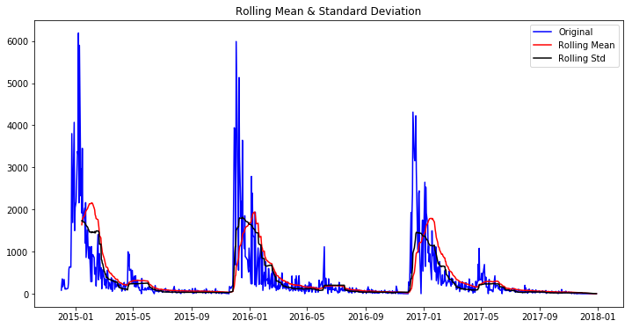
The SARIMA Model
ARIMA requires stationarity, which proved to be extremely difficult with this data (see peaks at the end and beginning of year)
Ultimately SARIMA was used, and a gridsearch determined the best parameters, but it took a lot of time
A forecast was generated, but there were very large confidence intervals
Testing against observed data yielded an MSE of 145,107.43

Slide 4
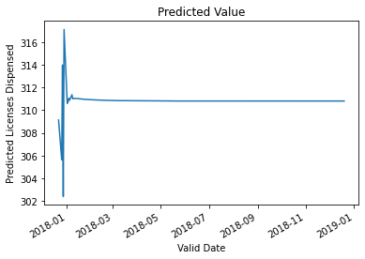
The LSTM Model
Next a more complex neural network was attempted
Data was prepared to fit an LSTM model
Model was built and trained on historical data, then tweaked until it yielded the lowest feasible MSE
A function was written to recursively forecast licenses for a given number of steps into the future
The MSE for this forecast was 115,307.38

Slide 5
What does that mean for the business?
I would not use the SARIMA because of the long amount of time to find the best parameters, and the seasonal spikes negatively affect the forecast
I would recommend using the LSTM model, with the caveat that it should not be used for a large number of steps. We can see that the model will begin to converge on itself over time, reducing accuracy
The benefit of the LSTM is that it handles the seasonality well, and despite being a neural network, took only 5 seconds to train.
As a manager, this data can be used to predict short term trends, and help provide staffing and resources in dog licensing centers

Slide 6
Where do we go from here?
Research should be completed as to why there are significant spikes in December and January
There’s always room to tune the LSTM model. I would recommend optimizing the number of days the model lags on, and potentially adding more years of data to try and make the model smarter.
A multivariate model using the categorical data could potentially yield some unexpected insights
Reframing the data into a SQL database could also be useful to further investigate any relationships in the data that may not be obvious otherwise

Slide 7
Thank you for your participation!
Any questions?

